Slide 1





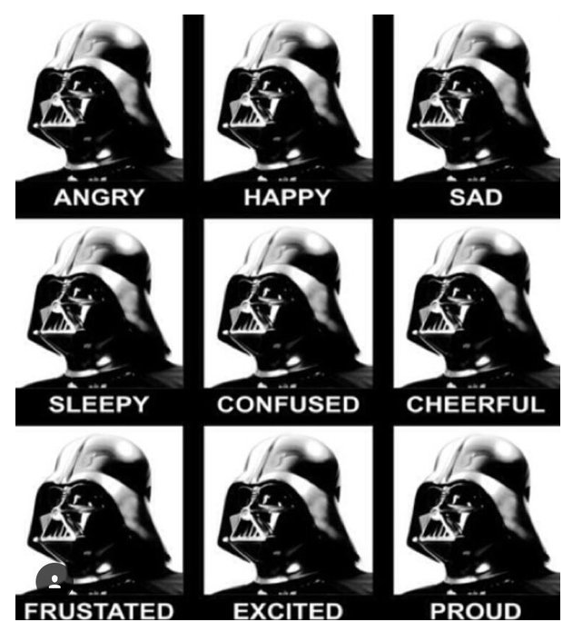


HTML
CSS
JAVASCRIPT
LEAFLET
Can a trail’s popularity be predicted by its features?

Slide 2
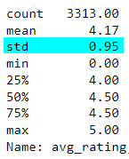
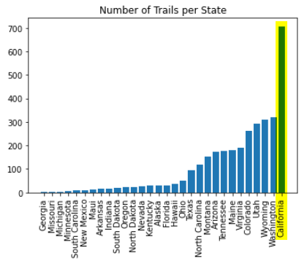
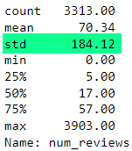
AVERAGE RATING
The average ratings are tightly distributed. Difficult to distinguish excellent vs good trails.
NUMBER OF REVIEWS
Trail popularity, based on the number of reviews, has wide variation.
What drives a trail’s popularity?

Slide 3
